Slide 1
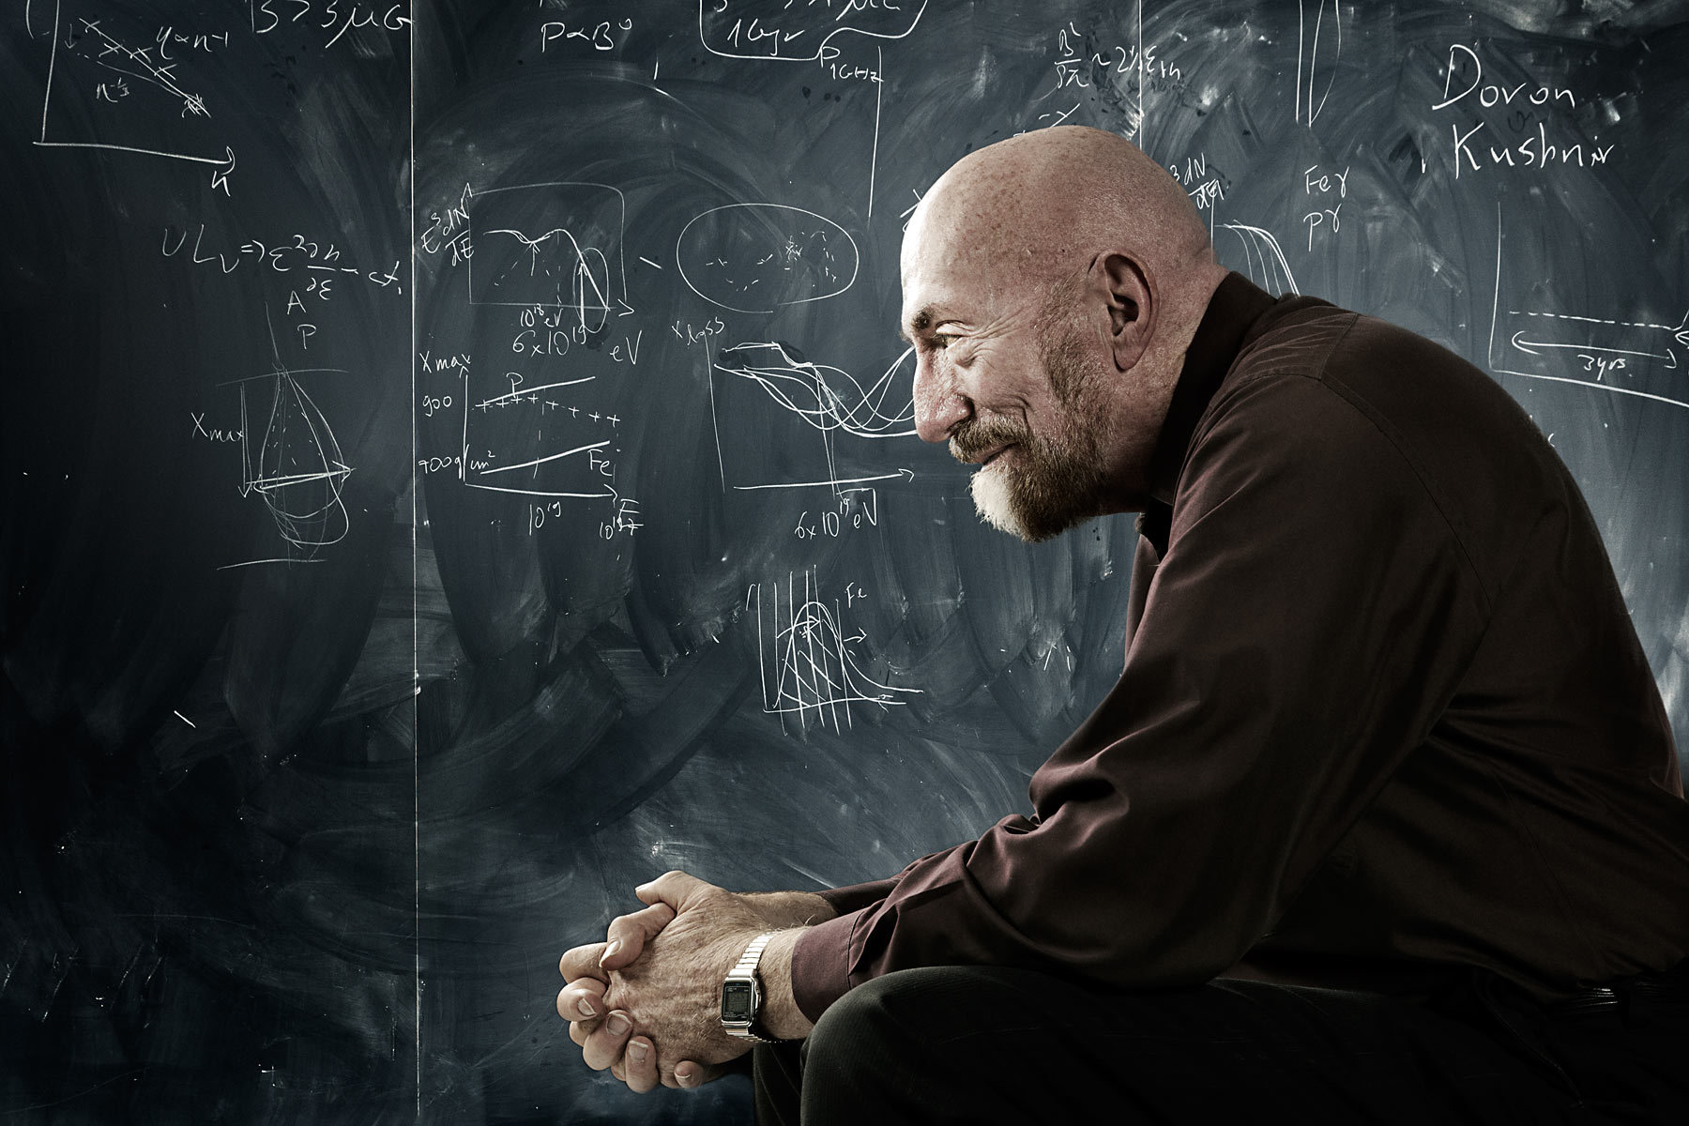
Kip S. Thorne: Life and Accomplishments
By Karina Rahaman

Slide 2
Early Life
Born June 1, 1940 in Logan, Utah
Son of Professors D. Wynne Thorne, soil chemist, and Alison C. Thorne, economist
His parents taught at the Utah State University
His interest in physics and space was sparked after seeing a lecture on the solar system
He began to work on calculations with his mother to make a solar system model

Slide 3
Education
He went to California Institute of Technology for a Bachelor’s Degree and graduated in 1962
He received his Ph.D. at Princeton University in 1965
Thorne returned to California Institute of Technology in 1967 to teach as one of the youngest associate professors
In 1991 Thorne became the Feynman Professor of Theoretical Physics but left his position in 2009

Slide 4
Thorne’s Accomplishments
Placed heavy focus on gravitation physics and relativistic astrophysics
Most famous for this theory on wormholes in space
LIGO and gravitational waves
Made developments with black holes
Interstellar

Slide 5
LIGO and Gravitational Waves
According to Einstein’s theory of General Relativity gravity is the result of the curvature of spacetime
The more mass, the greater the curve in spacetime
Gravitational waves are created when objects accelerate and cause wave-like movements that propagate out
In the 1960s and 1970s, Thorne predicted that relativistic stars pulsate and emit gravitational waves
Thorne supported LIGO in the 1980s and believed in the existence of gravitational waves
LIGO (Laser Interferometer Gravitational Wave Observatory) was created to detect gravitational waves
Cofounder with Rainer Weiss and Ronald Drever of LIGO in 1992

Slide 6
Black holes
Black holes are warped spacetime
Time slows as you approach the horizon and then time flows together in the singularity
Black holes bend light around it
Black holes are made wholly of spacetime and the mass and energy of the black hole is tied in the curvature of spacetime
https://www.youtube.com/watch?v=3WLAOzgEwTw#t=37

Slide 7
Wormholes
Carl Sagan believes Schwarzschild black holes can be used for time travel
Thorne believes that space can bend, stretch, and squeeze as objects move through it
Wormholes are the result of warped space that can serve as a shortcut between two different points in the universe
Wormholes can be used to time travel
Michael Morris and Kip Thorne realized a wormhole would be the mass of a galaxy and also require negative mass material → dark energy

Slide 8
Sources
http://www.its.caltech.edu/~kip/scripts/biosketch.html
http://www.cco.caltech.edu/~kip/scripts/cv.html
http://www.famousscientists.org/kip-s-thorne/
http://discovermagazine.com/2007/nov/the-man-who-imagined-wormholes-and-schooled-hawking
http://www.space.com/17086-bizarre-black-holes-kip-thorne-interview.html
http://www.physics.uofl.edu/wkomp/teaching/spring2006/589/final/wormholes.pdf

